Slide 1
Algorithms Lecture 1
Module Leader : Dr. Mostafa Salama
Module Code: Analysis of Algorithms
Module Code: 16CSCI01I
Module Aim:
Analyse the amount of resources needed to solve a given computational problem.
Compare the efficiency of using different algorithms in addressing and solving the problem.
Module Content:
Principles of Algorithm Analysis [Brute Force algorithms]
Complexity, non-recursive algorithms and recursive algorithms
Greedy Algorithms.
Divide and Conquer Algorithms.
Dynamic Programming Algorithms.
Genetic algorithms
Module Evaluation:
Assignment :20%, Published in Sunday week 7 and delivered week 10
Class Test :30%, on week 9
Final Exam :50%
Lecture notes : 1

Slide 2

Algorithms [Definitions]
An algorithm is a step-by-step procedure for solving a problem in a finite amount of time.
A problem is Description of Input-Output relationship
Problem: is to
Get a group of sisters.
And
return this group as sorted.
Input
Output
Algorithm
The required in this module is to select the best algorithm technique of the shortest running time and lowest complexity.
The complexity of an algorithm is the amount of work required by this algorithm to solve a problem.

Slide 3
Algorithms [Complexity]
How to measure the complexity of an algorithm?
Execution time is not suitable because it is specific to a particular computer.
Number of statements vary according to the programmer and the programming language.
Complexity is dependent on the number of primitive steps that are executed by the pseudo code of algorithm.
The complexity of the algorithm is dependent on the problem size (N). The complexity now is independent of the hardware/software environment.
Sample Complexity calculation:
for(int i=0; i<n; i++)
for(int j=0; j<n; j++)
for(int k=0; k<n; k++)
cout<<i+j+k<<endl;
Problem size here is n
Complexity is a function of n
Number of primitive steps is n³
Then complexity of this code is n³
Iterating Step
Primitive Step

Slide 4
Algorithms [Complexity]
The asymptotic analysis of an algorithm is a rough measure of the algorithm complexity to determine the running time in big-Oh notation. As shown below, 2n+n² is roughly n²
Selection sort algorithm to sort a[0] to a[n-1] is the array to sort
void selectionSort (int a[]){
int i,j;
for (j = 0; j < n-1; j++) {
int iMin = j;
for ( i = j+1; i < n; i++) {
if (a[i] < a[iMin])
iMin = i;
}
if(iMin != j)
swap(a[j], a[iMin]);
}}
Then the counted number of steps are = n*(1+n*(1)+1)
= (1*n) + (1*n*n) +(1*n)
= 2n+n² = O(n²)
Function definition not counted
Variable declaration not counted
Iterators not counted
Variable assignment counted (1*n)
Iterators not counted
Condition Statement not counted
Variable assignment counted (1*n*n)
Condition Statement not counted
Function Call counted (1*n)

Slide 5
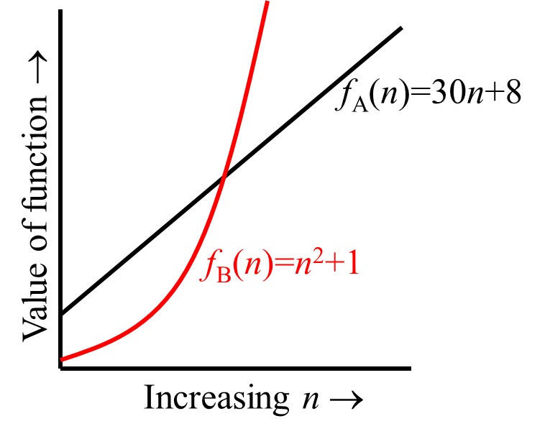
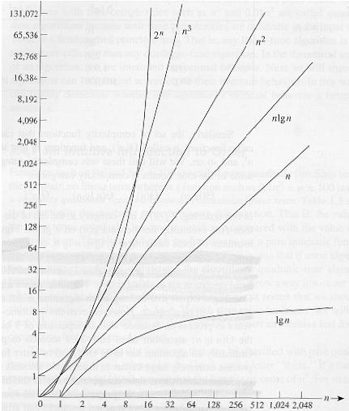
Algorithms [Complexity]
As the algorithm has a less complexity, for example T(n)=n² is less than T(n)=n³, as the better of this algorithm.
The growth rates of T(n) functions shows how much the number of steps of an algorithm increases according to the size of the problem.
For an algorithm of T(n) of O(nlogn) is much better than another algorithm of T(n) of O(n²) , where that both algorithms are solving the same problem. As long as this problem size (n) increases as the nlogn algorithm become faster and faster than the n² algorithm.
Growth rate table of popular T(n) function
n | logn | n | nlogn | n² | n³ | 2^{n}
4 | 2 | 4 | 8 | 16 | 64 | 16
8 | 3 | 8 | 24 | 64 | 512 | 256
16 | 4 | 16 | 64 | 256 | 4,096 | 65,536
32 | 5 | 32 | 160 | 1,024 | 32,768 | 4,294,967,296
64 | 6 | 64 | 384 | 4,094 | 262,144 | 1.84 * 10¹⁹

Slide 6
Algorithms [Complexity]
O(g(n)) = {T(n) : There exist positive constants c and n₀
Such that 0≤T(n) ≤cg(n) for all n≥n₀}
2n² = O(n³) : 0≤2n²≤cn³ ➔0≤2≤cn➔(2/c)≤n➔n₀=2,c=1
n² = O(n²) : n² ≤ cn² ➔ c ≥ 1 ⇒ c = 1 and n₀= 1
10n²+3n = O(n²): 10n²+3n≤10n²+3n²=13n²≤cn²➔c=13 and n₀=1
103=O(1): 103 ≤c*1 ➔ c≥ 103
2n³ = O(n²): 0≤2n³≤cn² ➔0≤2n≤c➔n≤(c/2)
Contradiction: n cannot be smaller than a constant
Ω(g(n)) = {f(n) : There exist positive constants c and n₀
Such that 0≤cg(n)≤T(n) for all n≥n₀} Lower bound
Common series summation and Logarithms
At c=13
10n²+3n=13n²
3n=3n²➔n=1

Slide 7

Algorithms [Non-Recursive]
Selection is a Non-recursive Algorithms. Let us consider further examples of such type of algorithms like matrix multiplication. Given two n × n matrices A and B, find the time efficiency of the definition-based algorithm for computing their product C = AB.
for i ←0 to n − 1 do
for j ←0 to n − 1 do
C[i, j ]←0.0
for k←0 to n − 1 do
C[i, j]←C[i, j]+ A[i, k] ∗ B[k, j]
return C
n=4
Let the total number of multiplications T(n)
$$T\left(n\right)=\sum_{i=0}^{n−1}{\sum_{j−0}^{n−1}{\sum_{k=0}^{n−1}{1}}}= \sum_{i=0}^{n−1}{\sum_{j=0}^{n−1}{n}}=\sum_{i=0}^{n−1}{n^{2}}=n^{3}$$
So T(n) is O(n³)

Slide 8
Algorithms [Non-Recursive]
Consider that T(n) is a function that represents the number of steps in an algorithm T that deals with a problem of size n. For example sorting an array of size n in an ascending order.
Then O notation: g(n) is asymptotic upper bound of T(n)
T(n)=O(g(n)) implies: T(n) “≤” g(n)
For example, T(n) = 2n + n² + 2n³ + 32;
Then T(n) is O(n³) , where constants like 32 and 2 are ignored, and less power a in nª are also ignored.
The complexity of algorithm measured by the asymptotic notation O is independent on the problem data in some cases like the selection sort and matrix multiplication algorithms.
While in other cases, the complexity is dependent on the problem data like the insertion sort and binary calculation algorithms.

Slide 9
Algorithms [Non-Recursive]
Insertion sort algorithm to sort a[0] to a[n-1] is the array to sort.
void insertionSort (int a[]){
int j, temp;
for (int i = 0; i < n; i++){
j = i;
while (j > 0 && a[j] < a[j-1]){
swap(a[j], a[j-1]);
j--;
} } }
The value of x is the number of iterations in the while loop, which is dependent on the values in the array.
If the array is sorted in an ascending order, then the number of iteration x is only 1 which is the best case, So the function T(n)=1*n*1= n=O(n)
If the array is sorted in descending order, then the number of iteration x is of average value n which is worst case. So the function T(n)=1*n*n= n²=O(n²)
If the array is not sorted, then the number of iteration x is in-between zero and n, which is of average case.
Function definition not counted
Variable declaration not counted
Iterators not counted
Variable assignment counted (1*n)
Iterators not counted
Function call counted (1*n*x)
Variable increment (1*n*x)

Slide 10
Algorithms [Non-Recursive]
Another Non-recursive Algorithm dependent on the input data problem is decimal-to-binary converter. Let an algorithm finds the number of binary digits in the binary representation of a positive decimal integer.
25 ➔ 25/2 = 25/2¹= 12 ➔ 1
➔ 12/2 = 25/2² = 6 ➔ 0
➔ 06/2 = 25/2³ = 3 ➔ 0
➔ 03/2 = 25/2⁴ = 1 ➔ 1
➔ 01/2 = 25/2⁵ = 0 ➔ 1
string s= ̎̎̎ ̎;
while (n > 0){
if(n%2=0)
s= ̎ 0 ̎ +s;
else
s= ̎ 1 ̎+s;
n= ⌊n/2⌋;
}
return s;
11001
Number of steps here for n = 25 is x = 5 , log₂25=4.6
The number of steps x of this algorithm is based on the value of the input n.
Is x a function of n, that is to say x=T(n)?? Yes!!!!
[n/2¹], [n/2²] , [n/2³], … , [n/2^{x}]
The division of n by 2^{x} continues
Until ➔ 2^{x-1} ≤ n ≤ 2^{x} ➔(2^{x})*0.5 ≤ n ≤ 2^{x}
This means➔ log₂ 2^{x}+log 0.5 ≤ log₂ n
This means➔ x + -1 ≤ log₂ n
This means ➔ x ≤ 1+log₂ n
This means➔ x = T(n) ≤ 1+log₂ n ➔T(n)=O(log₂n)

Slide 11
Algorithms [Recursive]
Recursive Algorithms are another form of controls that replaces the iterations done by the looping controls as follows:
The four parts of recursion are
Termination condition is !i<n,
incrementing is i++;
Action is s = s + arr[i];
Recursive call ➔ arraySum(arr, n, i, s); to do the next iteration and when terminated goes back
int main(){
int arrayInts[3]={1,2,3};
cout<<arraySum(arr,3);
}
int arraySum(int arr[], n){
int s=0;
for(int i=0; i<n; i++)
s = s + arr[i];
return s;
}
int main(){
int arrayInts[3]={1,2,3};
cout<<arraySum(arr, 3, 0, 0);
}
int arraySum(int arr[], int n, int i, int s){
if(!(i<n))
return s;
else{
s = s + arr[i];
i++;
retun arraySum(arr, n, i, s);
}}
Base Case
Recursive
Case

Slide 12
Algorithms [Recursive]
Recursive Algorithms has two main cases, the base and recursive cases. The base case T(0) is represented by constant number. The reclusive case T(n) is represented by a function of the problem size n.
For example the array summation function
int Sum(int arr[], int n){
if(n ≤ 1)
return arr[0];
else{
return arr[n-1]+Sum(arr, n-1);
}
}
To analyze this recursive function to find its complexity (upper bound big O)
T(0) ≤ b
T(n) ≤ c+T(n-1) ≤ c+c+T(n-2) ≤ c+c+c+T(n-3) .. ≤ kc+T(n-k) for all k
T(n) ≤ cn+T(0) ≤ cn+b at k=n ➔ T(n) = O(n)
Base Case : T(0) ≤ b
Recursive Case: T(n) ≤ c + T(n–1) for n>1

Slide 13
Algorithms [Recursive]
Another example of recursive Algorithms analysis is the Fibonacci function. Fibonacci series is 0, 1, 1, 2, 3, 5, 8, 13, 21, 34, ….
So Fib(9) is the ninth number in the series is 34
int Fib(int n){
if(n ≤ 1)
return n;
else{
return Fib(n-1)+Fib(n-2);
}
}
To analyze this recursive function to find its big O
T(0)=T(1)=1 ≤ b
T(n) ≤ T(n-1)+T(n-2)+c , to reduce this expression, since T(n-1)>T(n-2)
T(n) ≤ 2T(n-1)+c ≤ 4T(n-2)+2c ≤ 8T(n-3)+3c
T(n)≤ 2^{k}T(n-k)+kc
T(n) ≤ 2^{n}T(0)+nc ≤ 2^{n}b+nc at k=n ➔ T(n) = O(2^{n})
Note here that this recursive function has many redundant steps.
Base Case : T(0)=T(1)=1 ≤ b
Recursive Case: T(n) ≤ T(n–1)+T(n-2)+c for n>1

Slide 14
Algorithms [Recursive]
Another example is decimal-to-binary conversion using recursion.
String decTobin(int n, string s){
if(n ≤0)
return s;
else{
s=(n%2=0;"0"+s;"1"+s);
return decTobin(⌊n/2⌋, s);
} }
To analyze this problem using master theorem, it is required first to map the reclusive case equation to increasing function f.
f(n) = a f(n/b) + cn^{d}
The recurrence function will be T(n) = 1*T(n/2)+cn⁰
In this case , a=1, b=2, c=1, d=0
To analyze this recursion here
Base case : T(0) ≤ b
Recursive case: T(n) ≤ c+ cT(n/2)

Slide 15
Algorithms [Recursive]
Then the complexity of the recursive function is detected according to the values of a, b and c such that:
f(n) = O(n^{d}) if a < b^{d}
f(n) = O(n^{d} log₂ n) if a = b^{d}
f(n) = O(n ^{log a}) if a > b^{d}
From the decTobin function
The recurrence function T(n) = 1*T(n/2)+cn⁰, a=1, b=2, c=1, d=0
In this case, a=1, b^{d}=b⁰=1, then a= b^{d}
Then T(n)=O(n^{d}log₂n)=O(n⁰log₂n)=O(log₂n)
The complexity (upper bound) of decTobin is T(n)= O(log₂n)

Slide 16
Algorithms [Recursive]
Ex. T(n) = 4T(n/2) + n
a = 4, b = 2 ⇒ n^{logba} = n²; f (n) = n.
Case 1: f (n) = O(n^{2 – e}) for e = 1.
∴ T(n) = Q(n²).
Ex. T(n) = 4T(n/2) + n²
a = 4, b = 2 ⇒ n^{logba} = n²; f (n) = n².
Case 2: f (n) = Q(n²lg⁰n), that is, k = 0.
∴ T(n) = Q(n²lg n).
Ex. T(n) = 4T(n/2) + n³
a = 4, b = 2 ⇒ n^{logba} = n²; f (n) = n³.
Case 3: f (n) = W(n^{2 + e}) for e = 1
and 4(cn/2)³ £ cn³ (reg. cond.) for c = 1/2.
∴ T(n) = Q(n³).
Ex. T(n) = 4T(n/2) + n²/lg n
a = 4, b = 2 ⇒ n^{logba} = n²; f (n) = n²/lg n.
Master method does not apply.
In particular, for every constant e > 0, we have n^{e} = w(lg n).

Slide 17
Algorithms [Recursive]
Compute the factorial function F(n) = n! for an arbitrary nonnegative integer n.
Since
n!= 1 . . . . . (n − 1) . n = (n − 1)! . n for n ≥ 1
and
0!= 1 by definition,
we can compute F(n) = F(n − 1) . n with the following recursive algorithm.
ALGORITHM F(n) //Computes n! recursively
//Input: A nonnegative integer n
//Output: The value of n!
if n = 0
return 1
else
return F(n − 1) ∗ n
Since the function F(n) is computed according to the formula
F(n) = F(n − 1) . n for n > 0,
Master theorem is not applicable in this form of the recursive function. Instead method of backward substitutions is utilized .
M(n) = M(n − 1) + 1 substitute M(n − 1) = M(n − 2) + 1
= [M(n − 2) + 1]+ 1= M(n − 2) + 2 substitute M(n − 2) = M(n − 3) + 1
= [M(n − 3) + 1]+ 2 = M(n − 3) + 3.
A General formula for the pattern: M(n) = M(n − i) + i.
What remains to be done is to take advantage of the initial condition given. Since it is specified for n = 0, we have to substitute i = n in the pattern’s formula to get the ultimate result of our backward substitutions:
M(n) = M(n − 1) + 1= . . . = M(n − i) + i = . . . = M(n − n) + n = n.

Slide 18
Algorithms [Recursive]
Prove by induction of the correctness of recursion complexity.
For the Fibonacci sequence, prove by induction that recursive Fibonacci function Fib(n) = O(2^{n}).
For general prove , replace Fib(n) by T(n)
Is the initial values at n=0 are correct: T(0) = O(2^{n})?
Since that it is already known that T(0) ≤ b , which means that T(0) = O(1)
Since at n= 0, 2^{n}=2⁰=1, which means T(0) ≤ c*2^{n=0}=c*1=c, T(0) ≤c, then T(0) = O(2^{n}) is correct at n=0.
Assume T(n-1) = O(2^{n}), which means T(n-1) ≤ c2^{n}
Is T(n) = O(2^{n})?
Since T(n) ≤ 2T(n-1)+c, and since T(n-1) ≤ c2^{n} from the assumption
Then T(n) ≤ 2 * c2^{n} +c , let constant b = the constant 2*c
Then T(n) ≤ b2^{n}+c, ignore c, then T(n) ≤ b2^{n}
Therefore, T(n) = O(2^{n}) if T(n-1) = O(2^{n})
Accordingly, since T(0) = O(2^{n}) is correct from the initial step,
Then T(1) = O(2^{n}) is correct, and then T(2) = O(2^{n}) is correct too,
and so on for T(k)=O(2^{k}) for all k.
Then T(n)=Fib(n)=O(2^{n})

Slide 19
Algorithms [Paradigms]
Algorithm design techniques (or “strategies” or “paradigms”) are general approaches to solving problems algorithmically, applicable to a variety of problems from different areas of computing.
Several paradigms are presented for designing algorithms. This to enable the construction of efficient solutions to problems.
Brute force: is a straightforward approach to solving a problem, usually directly based on the problem statement and definitions of the concepts involved. e.g. selection and insertion sort algorithms. [All the algorithms in lecture 1 are of Brute force paradigm]
Greedy Algorithms: The solution is constructed through a sequence of steps. At each step the next optimal step is selected locally, without considering whether this step leads to the final global optimal solution or not. e.g. Minimal spanning tree and Knapsack problem.
Divide-and-Conquer: Divide the problem instance to several smaller sub-instances then solve each one independently. Finally, the solutions of these sub-instances are combined to form final solution. e.g. Merge and quick sort algorithm.
Dynamic Programming: Solve problem of divide-conquer where identical sub-instances are computed repeatedly. Smallest sub-instances are solved first and results are placed in table to be used to construct larger sub-instances solution. e.g. Longest Common Subsequence.
Genetic algorithms: Compute the fitness of each solution and select a the solutions according to their fitness value. Then perform crossover (combine each two solutions) to obtain new solutions. Finally perform mutation (make random changes on the combined solutions) to obtain new solutions. e.g. Knapsack problem.

Slide 20
Algorithms Lecture 1
To Do in Lab 1
Implement the insertion sort algorithm using c++ language
Use a counter to determine the number of steps
Compare between the values of this counter in two cases
The input array is already sorted
The input array is reversely sorted

